Slide 1
Hanyang University
Div. of Computer Science & Engineering
MAT220
Discrete Mathematics
Prof. Sooyong Kang
Slides for a Course Based on the Text
Discrete Mathematics & Its Applications
by Kenneth H. Rosen
(c)2001-2004, Michael P. Frank, revised by S. Kang
Notes:
Discrete Math - Module #0 - Overview
(c)2001-2003, Michael P. Frank

Slide 2
Instructor and TA
Instructor
  Prof. Sooyong Kang
  ITBT 601-1
  2220-1725
  sykang@hanyang.ac.kr
Teaching Assistant
  Mr. Byoungjun Seo (서병준)
  산학기술관 502호
  2220-4439
  sbj8388@hanyang.ac.kr

Slide 3
Text
Textbook
  Kenneth H. Rosen, “Discrete Mathematics and Its Applications”, 6th Edition, McGraw Hill
Presentation slides for lectures
  PPT file will be uploaded to the course homepage before each class
  How to access
    portal.hanyang.ac.kr ➔ on-line courses ➔ Discrete Mathematics ➔ class board

Slide 4
Policies
Original grading policy: Midterm(50%) + Final(50%)
Absence policy
  Three absences will downgrade the final grade by 1 step
    Ex. Tentative grade (by the original grading policy) A+ ➔ Final grade A
  More than 8 absences w/o due notice: definitely F
Late policy
  Definition of the ‘Late’: Appear within 15 min. after the class time
    After 15 minutes, no late but absence!
  Three times of late will be regarded as an absence
Escape policy: rigorous discipline for dishonesty
  Definition of the ‘Escape’: disappear w/o due notice after the attendance check and before class ends
  An escape will be regarded as two absences
  More than one escape: definitely F

Slide 5
Course Overview
(c)2001-2004, Michael P. Frank, revised by S. Kang
Notes:
Discrete Math - Module #0 - Overview
(c)2001-2003, Michael P. Frank

Slide 6
What is Mathematics, really?
It’s not just about numbers!
Mathematics is much more than that:
But, these concepts can be about numbers, symbols, objects, images, sounds, anything!
Mathematics is, most generally, the study of any and all absolutely certain truths about
any and all perfectly well-defined concepts.
(c)2001-2004, Michael P. Frank, revised by S. Kang
Notes:
Discrete Math - Module #0 - Overview
(c)2001-2003, Michael P. Frank

Slide 7
What is Mathematics, really?
Determining the Truth of a concept
Deriving new True concepts from already-known true concepts
Everything pure mathematicians do is “Proving by logical thinking”
Mathematics is the study of
Truths (True or False) about concepts.
(c)2001-2004, Michael P. Frank, revised by S. Kang
Notes:
Discrete Math - Module #0 - Overview
(c)2001-2003, Michael P. Frank

Slide 8
So, mathematics is, in a word,
Proving !
Maybe somewhat unfamiliar to all of you
Maybe not interesting to most of you
Maybe very tedious to some of you
(c)2001-2004, Michael P. Frank, revised by S. Kang

Slide 9
Proving
A sequence of actions
  that invoke statement modifications
  from a True statement to another True statement,
  where the new statement is closer to the final True statement
(c)2001-2004, Michael P. Frank, revised by S. Kang

Slide 10
Why CS needs math?
Program: A sequence of instructions
  that invoke value transition
  from a correct value to another correct value,
  where the new value is closer to the final correct value
Programming, in its nature, corresponds to the Proving !
(c)2001-2004, Michael P. Frank, revised by S. Kang

Slide 11
Program Example
Find the sum of integers from 1 to 100
  int i, result = 0;
  for (i=1; i<=100; i++) result += i;
  Value transitions of the ‘result’:
      0 : initial correct value
      1 : sum of integers from 1 to 1, correct!
      3 : sum of integers from 1 to 2, correct!
      • • •
      5050 : final correct value
transition
transition
transition
(c)2001-2004, Michael P. Frank, revised by S. Kang

Slide 12
Corresponding Proof
The sum of integers from 1 to 100 is 5050
  Proof) We know that the sum of integers from 1 to 1 is 1.
  If we add 2 to 1 then the result is 3. Shortly, (1)+2=3. (T)
  If we add 3 to 3 then the result is 6. Shortly, (1+2)+3=3+3=6. (T)
  If we add 4 to 6 then the result is 10. Shortly, (1+2+3)+4=6+4=10. (T)
  • • •
  If we add 100 to 4950 then the result is 5050. Shortly, (1+2+3+…+99)+100=4950+100=5050. (T)
  Hence, the sum of integers from 1 to 100 is 5050. (T)
(c)2001-2004, Michael P. Frank, revised by S. Kang

Slide 13
What’s this class about?
What are “discrete structures” anyway?
“Discrete” - Composed of distinct, separable parts. (Opposite of continuous.)
discrete:continuous :: digital:analog
“Structures” - Objects built up from simpler objects according to some definite pattern.
“Discrete Mathematics” - The study of discrete, mathematical objects and structures.
(c)2001-2004, Michael P. Frank, revised by S. Kang
Notes:
Discrete Math - Module #0 - Overview
(c)2001-2003, Michael P. Frank

Slide 14
Ex. Discrete Structure ‘Hangul’
Hangul = An object (set) built up from simpler objects (sets) which are 초성, 중성 and 종성
  초성 ({ㄱ, ㄲ, ㄴ, ㄷ, ㄸ, …}) = An object built up from simpler object, called 자음 {ㄱ, ㄴ, ㄷ, …. , ㅎ}
  중성 ({ㅏ, ㅑ, ㅝ, ㅟ, …}) = An object built up from simpler object (set), 모음 ({ㅏ, ㅑ, ㅓ, ㅕ, … , ㅡ, ㅣ})
  종성 ({ㄱ, ㄴ, ㄶ, ㄻ, …}) = An object built up from simpler objects which are 자음 and NULL
(c)2001-2004, Michael P. Frank, revised by S. Kang

Slide 15
Discrete Structures We’ll Study
Propositions
Predicates
Proofs
Sets
Functions
Orders of Growth
Algorithms
Integers
Summations
Sequences
Strings
Permutations
Combinations
Relations
Graphs
Trees
Logic Circuits
Automata
(c)2001-2004, Michael P. Frank, revised by S. Kang
Notes:
Discrete Math - Module #0 - Overview
(c)2001-2003, Michael P. Frank

Slide 16
Relationships Between Structures
“→” :≝ “Can be defined in terms of”
Groups
Programs
Proofs
Trees
Complex
numbers
Operators
Propositions
Graphs
Real numbers
Strings
Functions
Integers
Relations
Matrices
Natural
numbers
Sequences
Infinite
ordinals
Bits
n-tuples
Vectors
Sets
Not all possibilities
are shown here.
(c)2001-2004, Michael P. Frank, revised by S. Kang
Notes:
Discrete Math - Module #0 - Overview
(c)2001-2003, Michael P. Frank

Slide 17
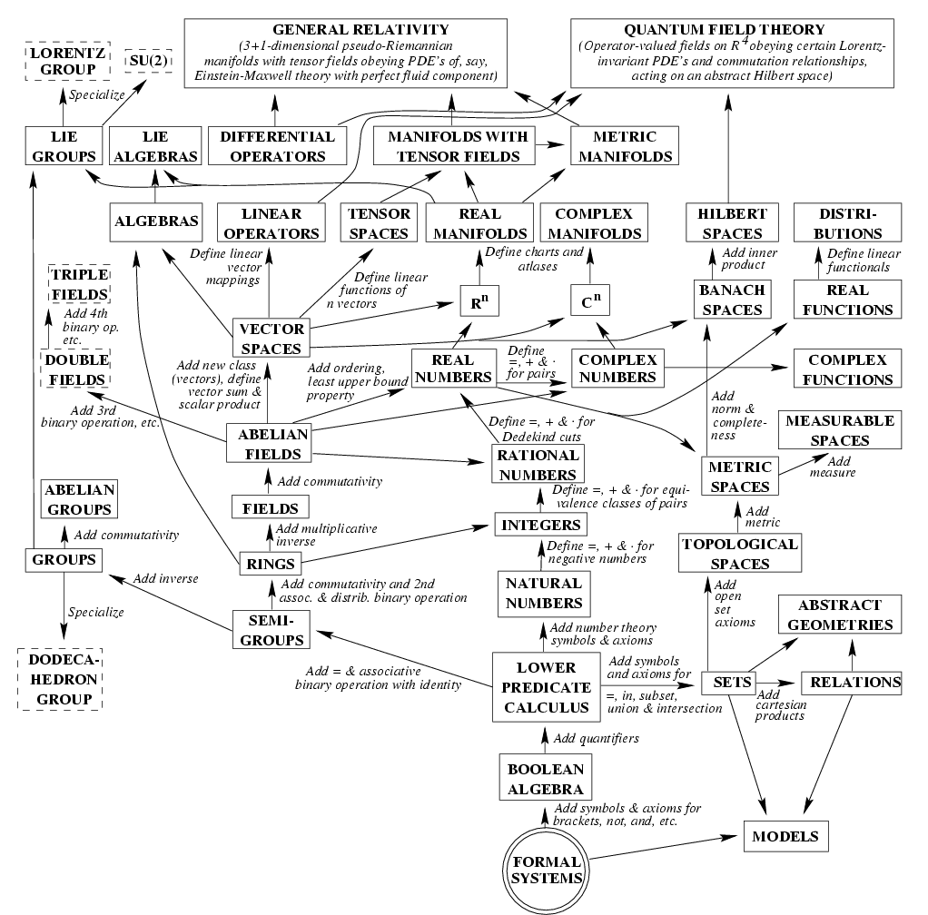
Physics from Mathematics
Starting from simple structures of logic & set theory,
  Mathematics builds up structures that include all the complexity of our physical universe…
    Except for a few “loose ends.”
One theory of philosophy:
  Perhaps our universe is nothing other than just a complex mathematical structure!
    It’s just one that happens to include us!
From Max Tegmark, ‘98
(c)2001-2004, Michael P. Frank, revised by S. Kang

Slide 18
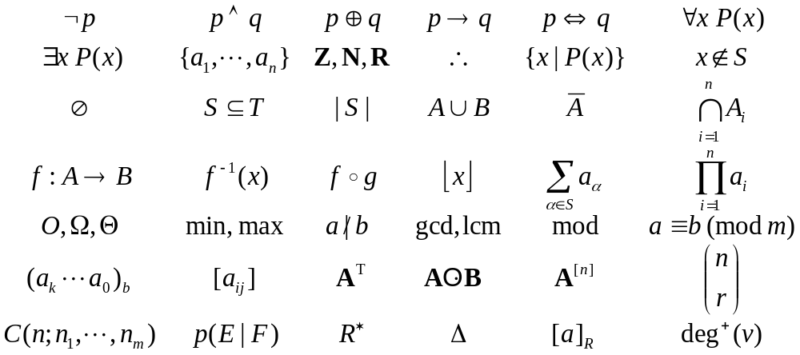
Some Notations We’ll Learn
(c)2001-2004, Michael P. Frank, revised by S. Kang
Notes:
Discrete Math - Module #0 - Overview
(c)2001-2003, Michael P. Frank

Slide 19
Why Study Discrete Math?
The basis of all of digital information processing is: Discrete manipulations of discrete structures represented in memory.
It’s the basic language and conceptual foundation for all of computer science.
Discrete math concepts are also widely used throughout math, science, engineering, economics, biology, etc., …
A generally useful tool for rational thought!
(c)2001-2004, Michael P. Frank, revised by S. Kang

Slide 20
Discrete versus Continuous
Most structures in the nature are continuous
  Time, Length, Weight, Sound, Scenery…
Most discrete structures are human-made
  Second, hour, month, year
  Meter, mile
  Gram, once, pound
  Frequency, amplitude
  Pixel
(c)2001-2004, Michael P. Frank, revised by S. Kang

Slide 21
Why human created discrete things?
To establish models of the nature
  Define indispensable virtual concepts that everyone agrees to and uses
    ex. Second, Kg, Km
  Formally describe the nature and mimic it
    ex. digital audio and video
  Derive an undiscovered knowledge from the formal models
    ex. Higgs boson: expected to ‘must be’ exist based on the (formal) standard model of the particle physics, and finally found it, recently.
(c)2001-2004, Michael P. Frank, revised by S. Kang

Slide 22
How to express discrete things?
We need to have a ‘language’ that can define and manipulate (discrete) things
A ‘Language’ consists of
  Symbols
  Rules to make a ‘sequence of symbols’
Mathematics provides methodology to define symbols and rules
  So, we study ‘(Discrete) Mathematics’
(c)2001-2004, Michael P. Frank, revised by S. Kang

Slide 23
What D.M. Provides
Logic (§1.1-4)
Proof methods (§1.5)
Set theory (§1.6-7)
Functions (§1.8)
Algorithms (§2.1)
Orders of Growth (§2.2)
Complexity (§2.3)
Number theory (§2.4-5)
Number theory apps. (§2.6)
Matrices (§2.7)
Proof strategy (§3.1)
Sequences (§3.2)
Summations (§3.2)
Countability (§3.2)
Inductive Proofs (§3.3)
Recursion (§3.4-5)
Combinatorics (ch. 4)
Probability (ch. 5)
Recurrences (§6.1-3)
Relations (ch. 7)
Boolean Algebra (ch. 10)
(c)2001-2004, Michael P. Frank, revised by S. Kang
Notes:
Discrete Math - Module #0 - Overview
(c)2001-2003, Michael P. Frank

Slide 24
Uses for Discrete Math in Computer Science
Advanced algorithms & data structures
Programming language compilers & interpreters.
Computer networks
Operating systems
Computer architecture
Database management systems
Cryptography
Error correction codes
Graphics & animation algorithms, game engines, etc.…
I.e., the whole field!
(c)2001-2004, Michael P. Frank, revised by S. Kang

Slide 25
Course Objectives
Upon completion of this course, the student should be able to:
  Check validity of simple logical arguments (proofs).
  Check the correctness of simple algorithms.
  Creatively construct simple instances of valid logical arguments and correct algorithms.
  Describe the definitions and properties of a variety of specific types of discrete structures.
  Correctly read, represent and analyze various types of discrete structures using standard notations.
(c)2001-2004, Michael P. Frank, revised by S. Kang
Notes:
Discrete Math - Module #0 - Overview
(c)2001-2003, Michael P. Frank

Slide 26
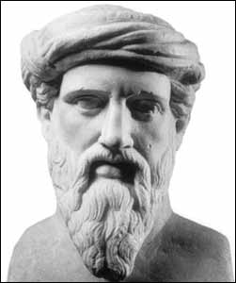
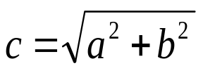
A Proof Example
Theorem: (Pythagorean Theorem
of Euclidean geometry) For any
real numbers a, b, and c, if a and b are the base-length and height of a right triangle, and c is the length of its hypo-
tenuse, then a² + b² = c².
Proof: See next slide.
Pythagoras of Samos
(ca. 569-475 B.C.)
b
a
(c)2001-2004, Michael P. Frank, revised by S. Kang
Notes:
Discrete Math - Module #0 - Overview
(c)2001-2003, Michael P. Frank

Slide 27
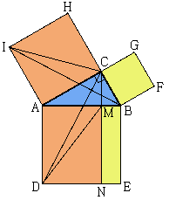
Proof of Pythagorean Theorem
Proof 1)
Yeah! I’ve seen it before, but I don’t like it.
(c)2001-2004, Michael P. Frank, revised by S. Kang

Slide 28
Proof of Pythagorean Theorem
Proof 2) Consider the below diagram:
  Exterior square area = c², the sum of the following regions:
    The area of the 4 triangles = 4(½ab) = 2ab
    The area of the small interior square = (b−a)² = b²−2ab+a².
  Thus, c² = 2ab + (b²−2ab+a²) = a² + b². ■
c
a
½ab
c
b
b
a
Very cool! I like it!
(b−a)²
½ab
½ab
b
a
c
b
a
½ab
c
(c)2001-2004, Michael P. Frank, revised by S. Kang

Slide 29
From where the difference arises?
“Simple is the best!”
  Steve Jobs, Apple Inc.
  It is true, at least in Mathematics.
How to make it ‘simple’?
  Creative thinking !
Before creative thinking,
  We should have basic knowledge and skills
(c)2001-2004, Michael P. Frank, revised by S. Kang

Slide 30
Fundamental Proof Techniques
Principle of Mathematical Induction
The Pigeonhole Principle
The Diagonalization Principle
(c)2001-2004, Michael P. Frank, revised by S. Kang

Slide 31
Finally: Have Fun!
1 Ⅹ 8 + 1 = 9
12 Ⅹ 8 + 2 = 98
123 Ⅹ 8 + 3 = 987
1234 Ⅹ 8 + 4 = 9876
12345 Ⅹ 8 + 5 = 98765
123456 Ⅹ 8 + 6 = 987654
1234567 Ⅹ 8 + 7 = 9876543
12345678 Ⅹ 8 + 8 = 98765432
123456789 Ⅹ 8 + 9 = 987654321
(c)2001-2004, Michael P. Frank, revised by S. Kang

